Slide 1
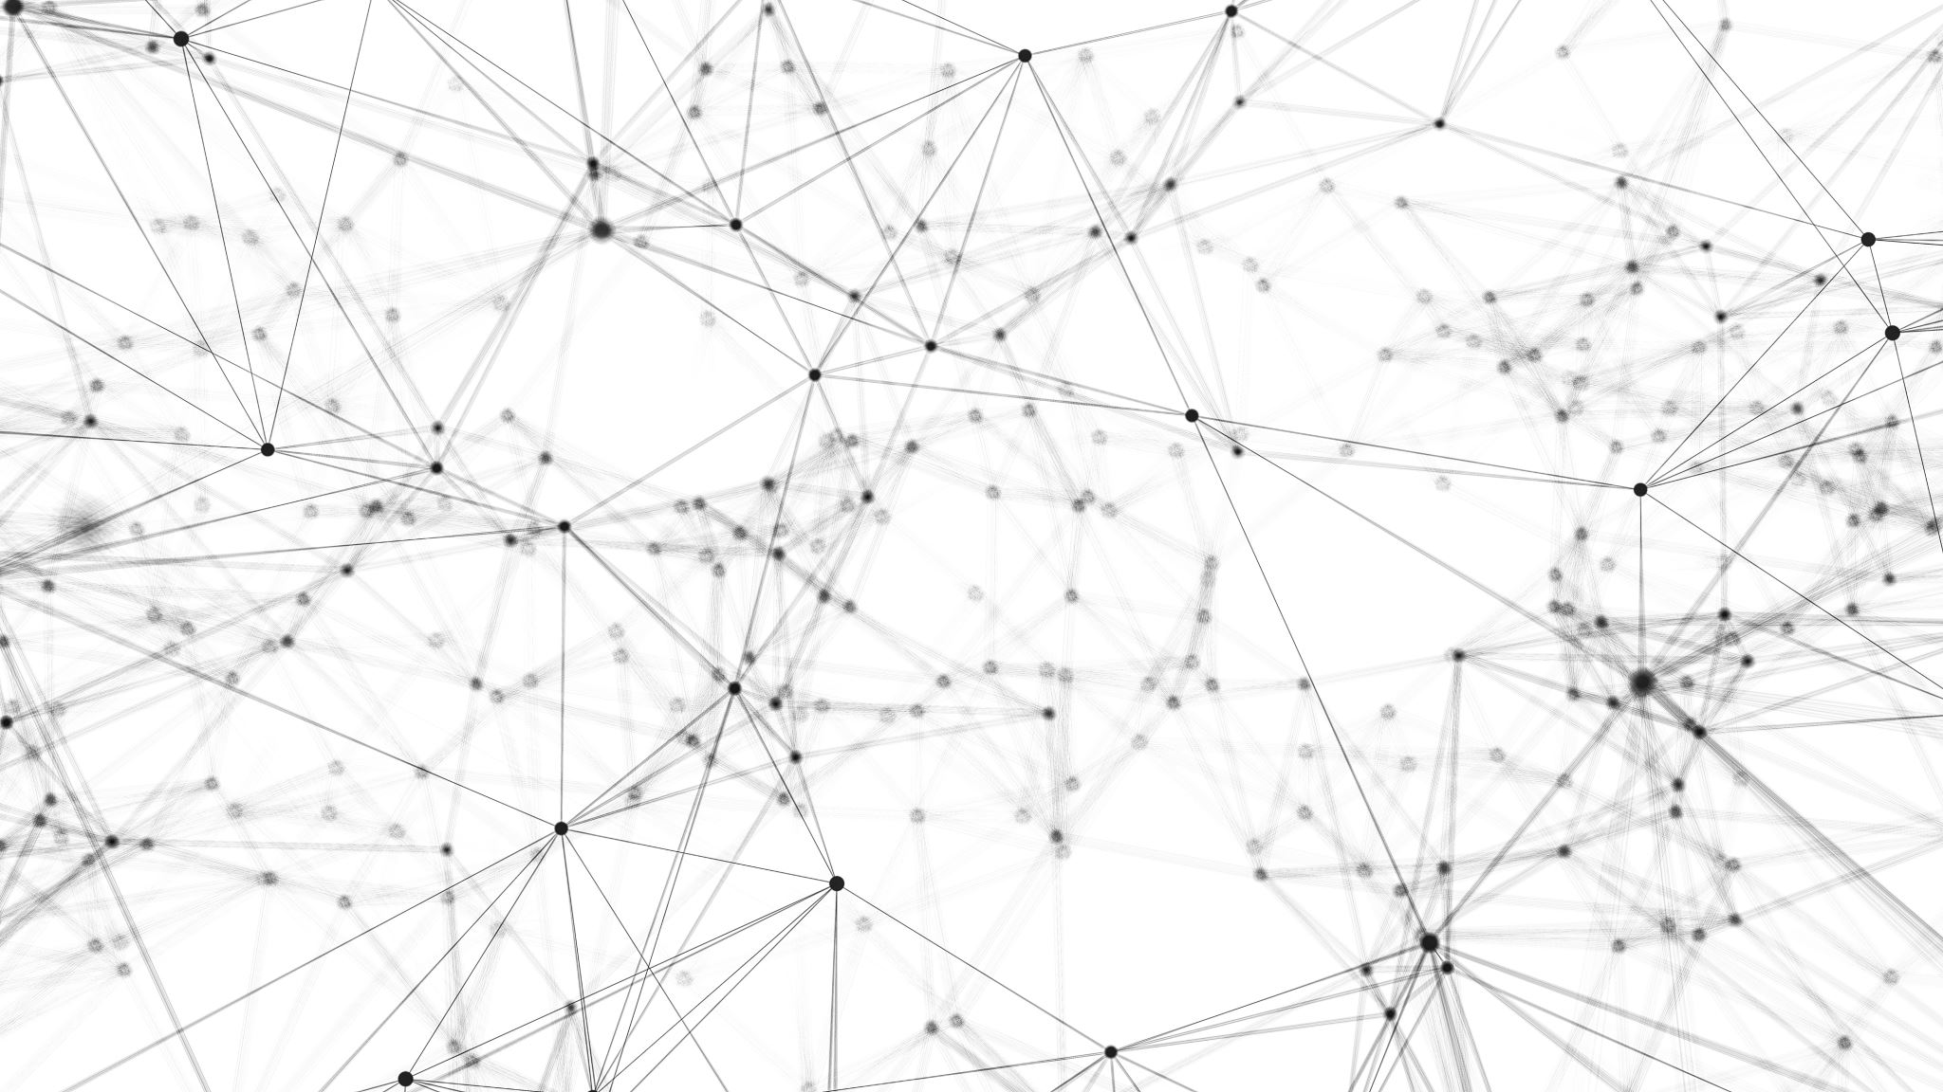
Locomotion in Virtual Reality
Theo Braune

Slide 2
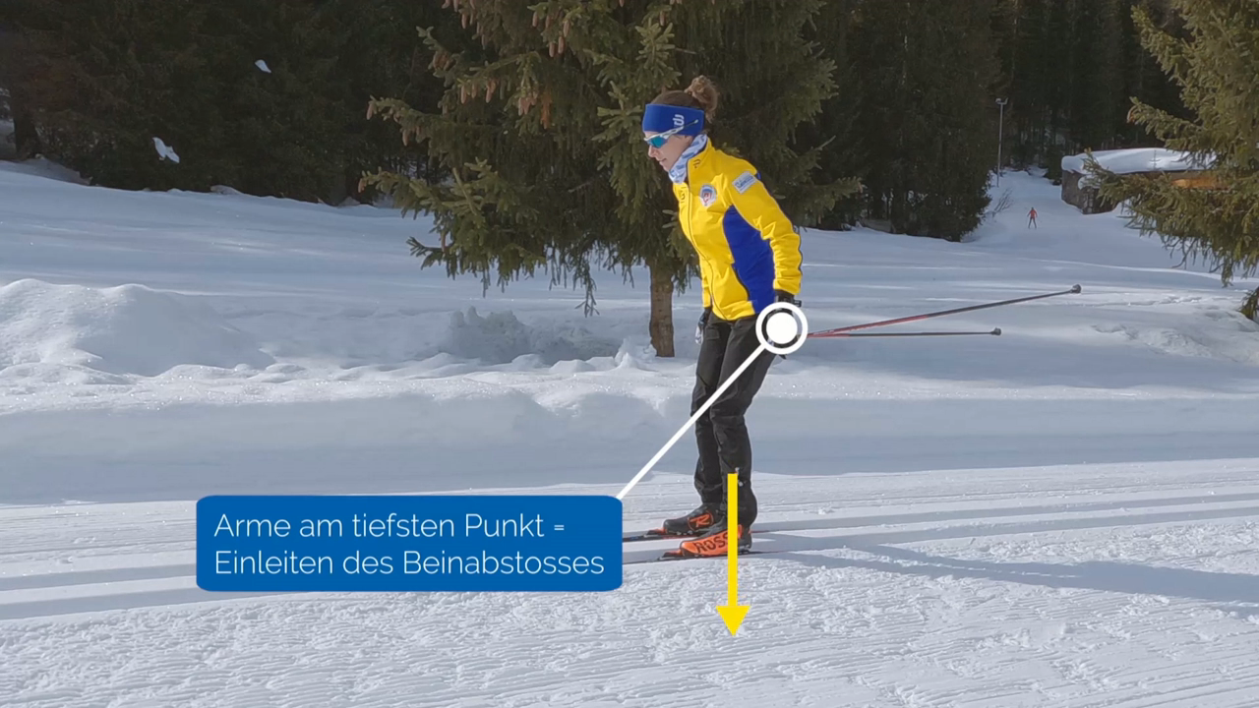
General idea
Cross-Country-Skiing
Every time a stroke is performed, a force pushes the rider forwards

Slide 3
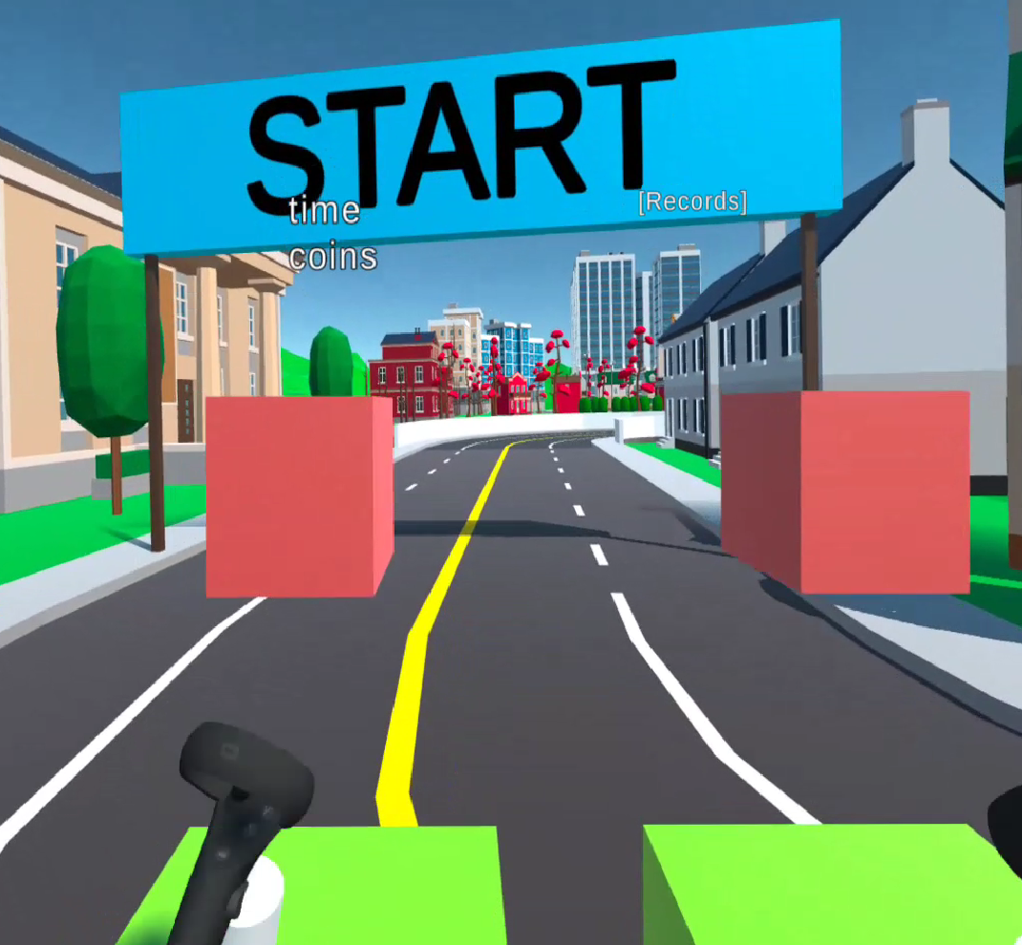
Implementation
Place four boxes in front of the rider/OVRCamera Rig
Use a collider for the controllers to detact if the left controller is moving from the upper to the lower box
If the movement is performed trigger a haptic feedback in the controller and play a hitting snow sound.

Slide 4
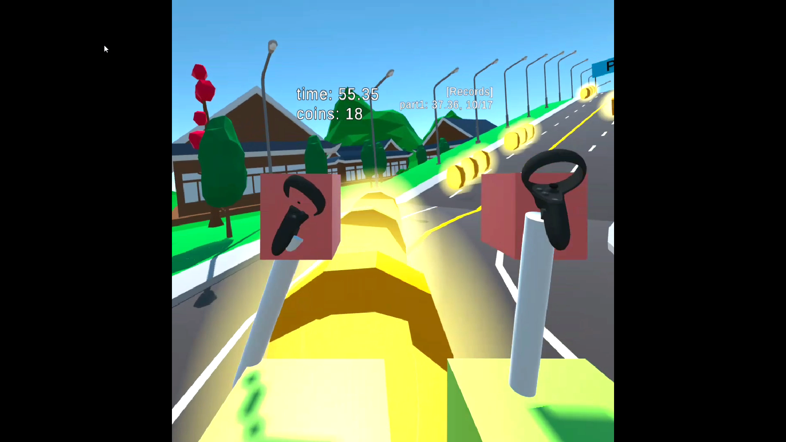
Implementation
In order to steer, perform a push, the force is directed in the viewing direction.
When going uphill, add supplementary drag, when going downhill, add negative drag.

Slide 5
Implementation
In order to steer, perform a push, the force is directed in the viewing direction.
When going uphill, add supplementary drag, when going downhill, add negative drag.
In order to get the corner, brake with the right secondary index trigger button.

Slide 6
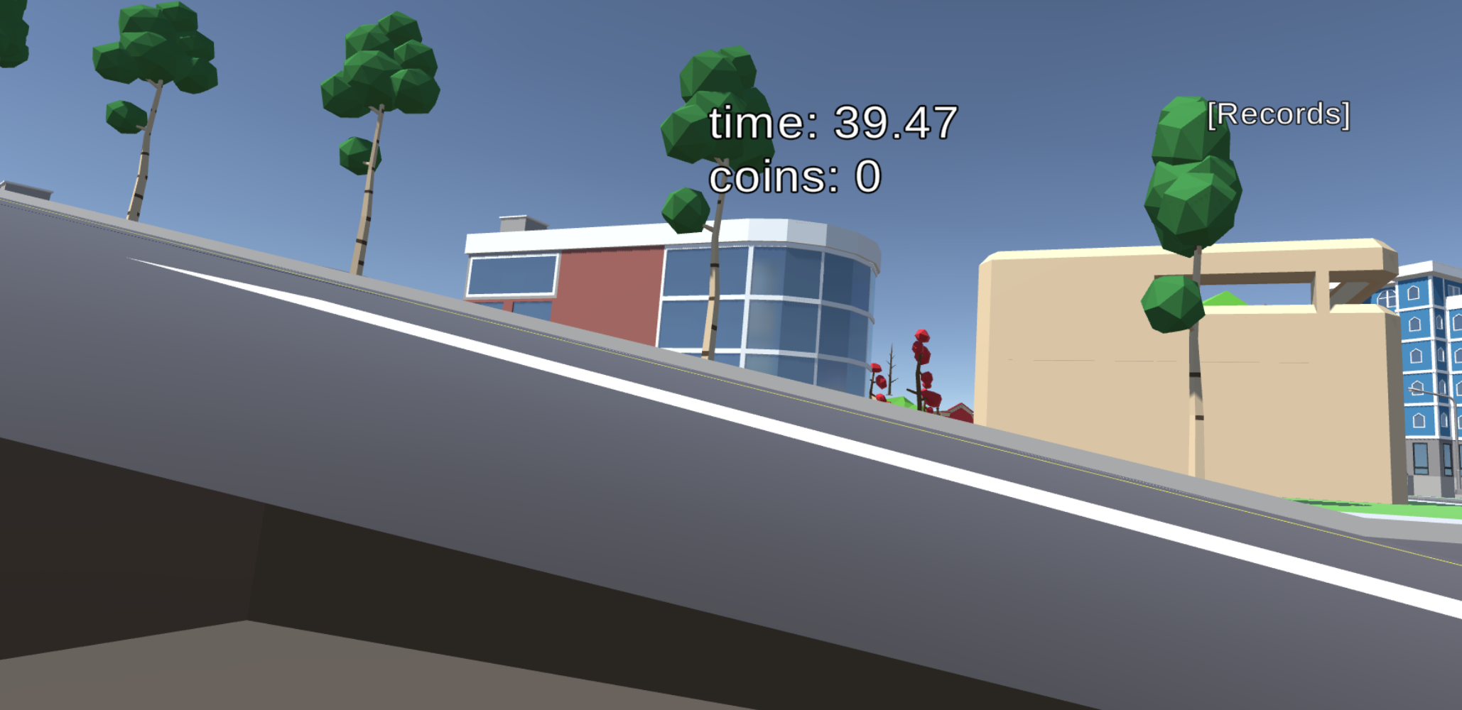
Implementation
The final coins for the jump are unachievable, one cannot jump.
The y-coordinate is pre-determined.

Slide 7
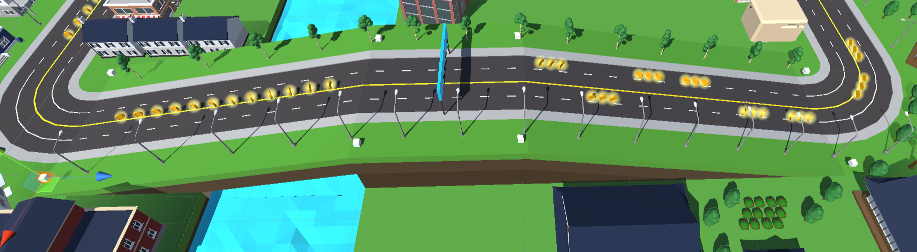
Implementation
The final coins for the jump are unachievable, one cannot jump.
The y-coordinate is pre-determined.

Slide 8
Evaluation
Participants new to the usage of the Virtual Reality needed more time to get familiar with the technology, but got comfortable with it
 |  |  |  |  |  | Mean
Sector 1 | 61 | 27 | 35 | 38.6 | 37.36 | 39.79
Sector 2 | 48 | 21 | 36 | 31 | 41.95 | 35.59
Sector 3 | 25 | 16 | 19 | 21 | 19.02 | 20.00
Total | 134 | 64 | 90 | 93 | 98.33 | 95.86

Slide 9
Evaluation
Precise steering in comparison to be fast is difficult.
The more coins are collected, the slower the run
 |  |  |  |  |  | Mean
Sector 1 | 61 | 27 | 35 | 38.6 | 37.36 | 39.79
Sector 2 | 48 | 21 | 36 | 31 | 41.95 | 35.59
Sector 3 | 25 | 16 | 19 | 21 | 19.02 | 20.00
Total time | 134 | 64 | 90 | 93 | 98.33 | 95.86
Accuracy | 0.37 | 0.2 | 0.77 | 0.72 | 0.7 | 0.51

Slide 10
Evaluation
Early version had a bug, gave downgrade for the presence score
Positive response for haptic feedback and sound (especially from those familiar with VR)
 |  |  |  |  |  | Mean
Total time | 134 | 64 | 90 | 93 | 98.33 | 95.86
Accuracy | 0.37 | 0.2 | 0.77 | 0.72 | 0.7 | 0.51
Presence | 7 | 5 | 6 | 7 | 7 | 6.4

Slide 11
Evaluation
In general not huge problems with cyber sickness as there is no flying and jumping
Nausea can appear through inertia in corners
 |  |  |  |  |  | Mean
Total time | 134 | 64 | 90 | 93 | 98.33 | 95.86
Accuracy | 0.37 | 0.2 | 0.77 | 0.72 | 0.7 | 0.51
Presence | 7 | 5 | 6 | 7 | 7 | 6.4
Sickness | 0 | 0 | 2 | 2 | 3 | 1.4

Slide 12
Evaluation
The user generally gave the feedback that they had fun
With only one rendered eye, there was a downscale
 |  |  |  |  |  | Mean
Total time | 134 | 64 | 90 | 93 | 98.33 | 95.86
Accuracy | 0.37 | 0.2 | 0.77 | 0.72 | 0.7 | 0.51
Presence | 7 | 5 | 6 | 7 | 7 | 6.4
Sickness | 0 | 0 | 2 | 2 | 3 | 1.4
Fun | 7 | 4 | 6 | 8 | 9 | 6.8

Slide 13
Evaluation
The user generally gave the feedback that they had fun
With only one rendered eye, there was a downscale
In comparison to others quite fast, relatively low accuracy with quite high presence

Slide 14
Conclusion
Advantages:
A lot of fun to use
Almost no cyber-sickness
Disadvantages:
Need to put them precisely in the boxes
No jumping
Precise and fast steering difficult
Advantage/Disadvantage: Physical demanding

